Slide 1
Using Geoprocessing Services with the ArcGIS JavaScript API
BY CALEB MACKEY

Slide 2
What is a Geoprocessing Service?
A Geoprocessing Service (GP Service) provides data management, conversion, and analytical capabilities as a service through the ArcGIS REST API.
A GP Service represents a published toolbox with a Python script tool or model. It can also be created from a Python Toolbox.
This is useful because the client does not need to have ArcGIS Desktop installed to run a GP Service; it is all ran by the ArcGIS Server in the backend via requests made through HTTP protocol.

Slide 3
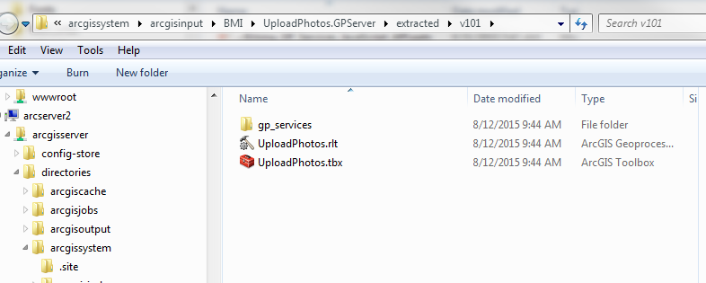
Creating a GP Service
In order to create a GP Service, you must publish the results of the tool that has been ran successfully in ArcMap/Catalog (not currently supported in ArcGIS Pro).
Open Geoprocessing Options > Results > Right click on tool that was ran > Share As > Geoprocessing Service
This will create toolbox locally on the server (arcgissytem/arcgisinput folder) with a single tool inside. The python script will reside here as well.

Slide 4
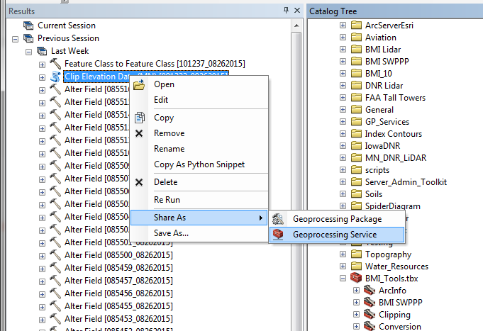
Publishing a GP Service

Slide 5
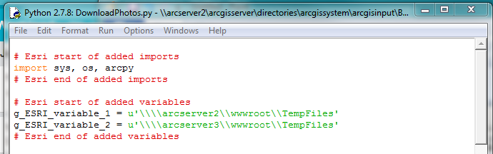
Server-Side Python Script
When a script tool is published, Esri uses an internal validation process to check all variables used in the script. If there are data/folder paths that are hard-coded in the script, a new variable is created.
This is done in case the resource was not previously registered with the data store and data was copied to the server. Therefore, any output folders or data sets used by script should be registered with the data store before publishing.
If any data is copied to the server, the “g_ESRI_variable_x” is changed to that path on the local server.

Slide 6
Server-Side Script Continued
In addition to checking for variables, ArcGIS also checks the script’s imports to make sure modules can be found within the Server’s PYTHONPATH.
If you are using custom or 3rd party module imports, you must make sure they can be imported by all servers within the ArcGIS Server site! Some useful strategies:
Have a custom Python library in a shared location within network. Then you can do one of these things:
Alter the Server10.x.pth file in the site-packages folder within the Python install folder to include the shared library path. You will have to do this every time a new version of Server is installed/upgraded.
Failsafe: Use the sys module to temporarily add the shared location to PYTHONPATH within script (removed from PYTHONPATH after script is ran)
sys.path.append(r“\\some_server\shared_py_library”)

Slide 7
Server-Side Script Continued
Third party/custom module import strategies continued:
Package custom module locally with the script in the gp_services folder on Server. However, now you are using a static copy of the custom module. Probably not the best option.
Because ArcGIS Server uses 64-bit Python, make sure any 3rd party modules used are the 64-bit versions.

Slide 8
Server-Side Script Considerations
Although a GP Service is just running a Python script on the backend, there are several important considerations:
ArcGIS Server runs 64-bit Python. What does this mean?
Personal geodatabase data sources and excel spreadsheets cannot be used (because they use a 32 bit driver)
Uses a slightly different arcpy package that is optimized for Server
Cannot use some extensions (spatial, 3D, geostatistical) unless using an Advanced License. No Exceptions! Hint: There are some workarounds for spatial analyst if using image server.
The script must be built to handle different types of input specific to a web environment such as Feature Sets (these are just JSON objects representing a collection of features).

Slide 9
Server-Side Script Considerations Continued
4. Determine whether a GP Service should be Synchronous or Asynchronous:
Synchronous – should be used for operations that execute quickly because the client has to wait for this job to complete (uses execute task)
Asynchronous – Should be used by processes that take a long time to complete and the client can do other things while the process is running. This avoids browser time outs (uses submit job)
While a GP Service is running asynchronously, the client makes continuous calls against the GP Job (via the jobID) to check on the status until the task completes (jobStatus = esriJobSucceded).
Cannot use tool validation in the traditional sense. Maybe with a Python toolbox?
1. Probably makes more sense to handle the input parameter validation on the JavaScript/HTML side

Slide 10
Important Concepts
GP Task – single tool that will be ran (Asynchronously or Synchronously)
http://your_server.com/arcgis/rest/services/folder/ToolName/GPServer/ToolName
GP Input – these represent the parameters that need to be passed in to the GP Service Task (as JSON)
Contains info about the parameter such as name, data type, etc.
GP Job – represents a job that was executed by the GP Service.
GP Result – JSON output for a GP Job. If there is an output parameter set in the script, it is returned with the GP Result.
Provides info about the result parameters as well as inputs. Similar to Geoprocessing Results in Desktop or arcpy.Result.

Slide 11
Integration with the ArcGIS JavaScript API
Because the client will be accessing GP Services through a web application, there is no “out of the box” GUI for the tools like in ArcMap or ArcCatalog.
Note: GP Services can be executed with any programming language that can make HTTP requests (like Python!)
It is up to the developer to create UI components and client side logic to execute GP Tasks because the parameters need to be passed from the web application to the Python Script. Making use of HTML5/CSS/JavaScript functionality is very important!
Remember not all browsers support all HTML5 functionality (like the File API)

Slide 12
Integration with the ArcGIS JavaScript API
On the Server-Side, the Python script must be able to take arguments from the client (if there are input parameters). How do these get into the script? Use ArcPy!
GetParameter – returns the parameter as an object. Useful for a feature set!
GetParameterAsText – returns a parameter value as a text string.
Note: you can also use the built-in sys module to get parameters as text
paramAsText = sys.argv[1] # first parameter, index 0 is script name
SetParameter – sets an output parameter for a tool from an object.
Very Important, you MUST use this if your tool has an output parameter and you want to access it from the Web Application after the task has ran
SetParameterAsText – sets an output parameter for a tool as a text string

Slide 13
Calling a GP Service in the JS API
To consume a GP Service, you must use the Geoprocessor class.
The parameters differ for every tool and therefore are passed in as JSON matching the parameter schema as defined in the service.
Tools that return output data are accessed after the geoprocessor’s execute or submit job callbacks. See getting the results from a GP Service.

Slide 14
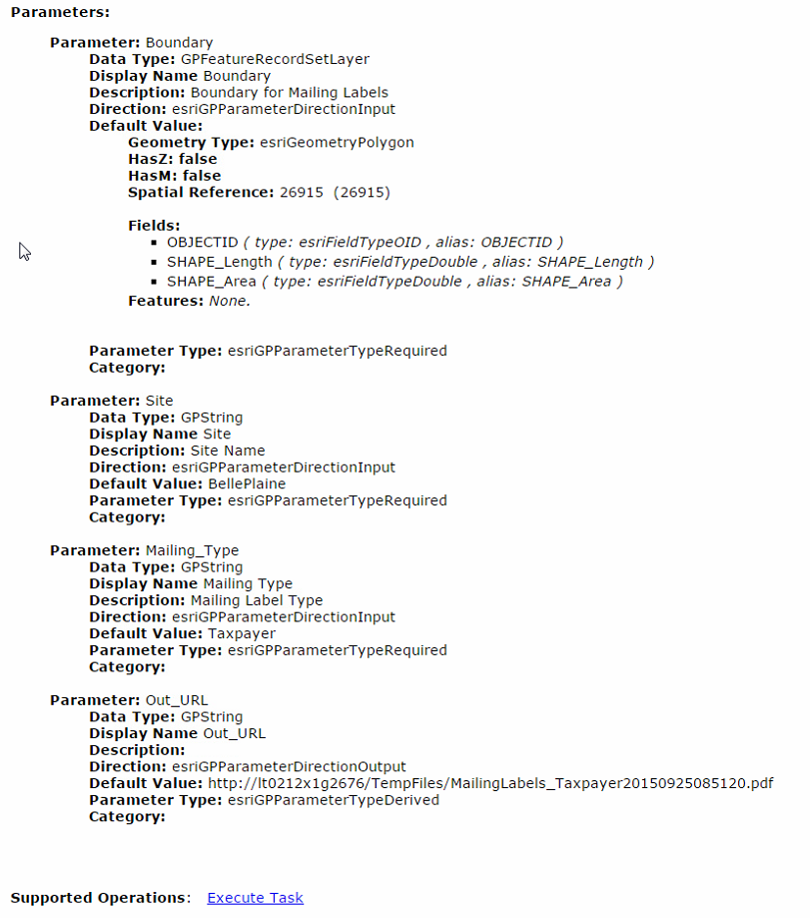
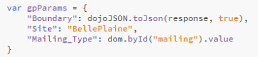
Because the “Out_URL” parameter direction is output, it is derived and is not referenced in the JSON parameter input shown above.

Slide 15
Getting the output from a tool
The callback from when the GP Service has finished executing returns two things for both execute (synchronous) and submit job (asynchronous):
results – includes any result data
messages – includes any messages returned during the process (this depends on the message level set for the GP service!)

Slide 16
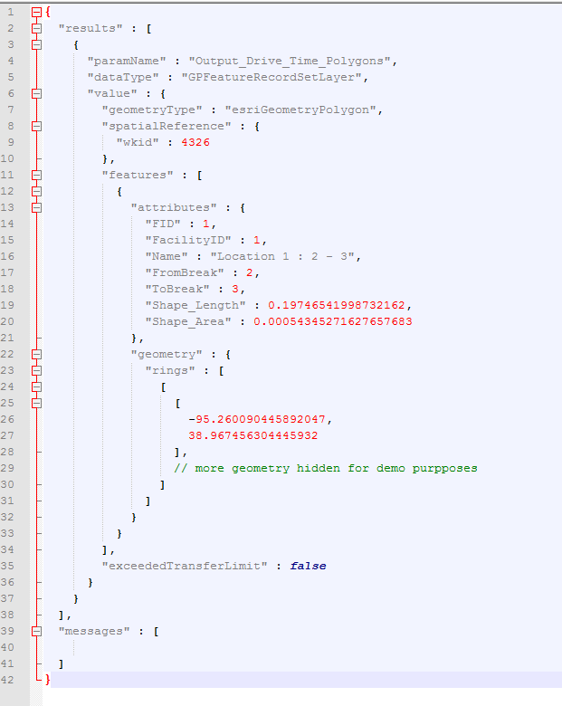
When calling a GP Service from a REST Endpoint, you can see what the JSON response would look like. When successful, it will return an array of results (usually just one) and messages.

Slide 17
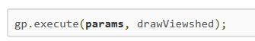
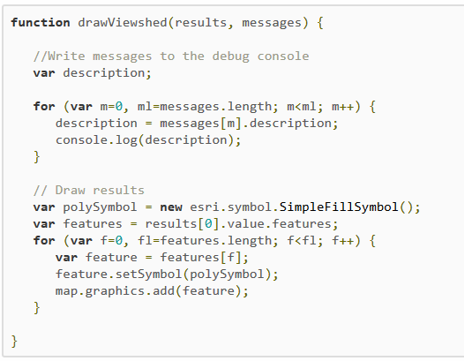
Getting the output from a Synchronous task
This example from the Esri help docs demonstrates how to handle the results. The drawViewshed() function is the callback for when the task has successfully completed (there is also an error callback function that can be used as a third parameter of the Geoprocessor.execute() method). The output parameter in this case is a Feature/Record Set.

Slide 18
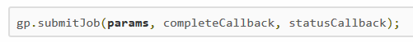
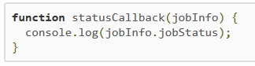
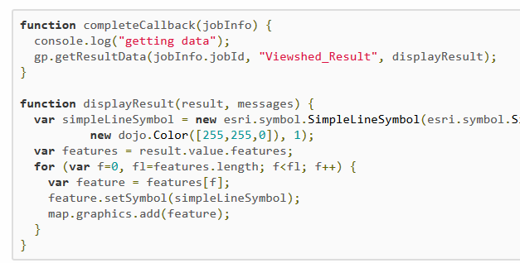
Getting the output from an Asynchronous task
There is a slightly different process with handling results from an Asynchronous process. While the job is executing, the GP framework will make repeated calls to the service to check the status (statusCallback() function will print out any messages along the way) until the job has completed.
If the job has completed successfully, a jobInfo object is returned. The jobId from the jobInfo object is then passed into the getResultData() method from the Geoprocessor where the second parameter is the output parameter name and the third parameter is the callback to do something with the output parameter.

Slide 19
Questions?
calebma@Bolton-menk.com
References
https://developers.arcgis.com/javascript/jsapi/
https://github.com/yusufshakeel/Web-App/blob/master/DialogBox/confirmBox.html
http://resources.arcgis.com/EN/HELP/MAIN/10.1/index.html#/Parameters/01540000054v000000/GUID-39A6B08B-4A90-4556-B922-42DF00529BD7/

